Slide 1
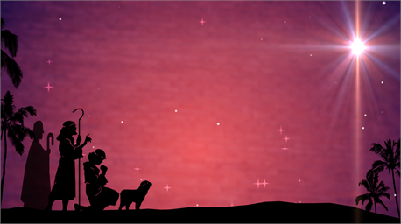

Hallelujah
or Humbug?

Slide 2
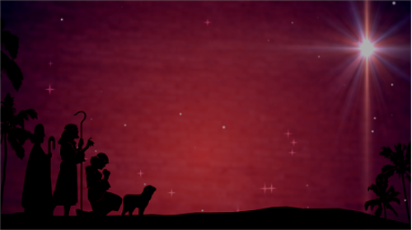

You just might be a Scrooge if …
You turn on the lawn sprinklers on Christmas Eve to keep carolers away
You buy all of your Christmas gifts at a store that also sells gas
You get your Christmas tree at a roadside rest stop after dark,
You give bathroom fixtures as Christmas gifts
Hallelujah or Humbug?

Slide 3
You just might be a Scrooge if …
Your favorite Christmas movie is “Gremlins”
Your favorite Christmas tradition is putting defective bulbs in your neighbors' string of Christmas lights
Your only holiday decoration is a 2-month old rotting pumpkin
Hallelujah or Humbug?

Slide 4
Hallelujah or Humbug?

Slide 5
Dec
Jan
Nov
Feb
Mar. 28
Oct
Mar
Sep
Apr
Aug
May
Jul
Jun
Hallelujah or Humbug?

Slide 6
Hallelujah or Humbug?

Slide 7
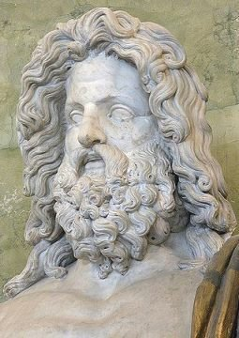
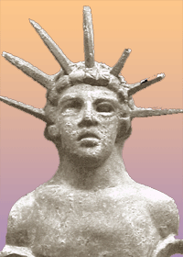
Saturnalia
Dec. 17-23
The Birthday of the Unconquerable Sun (Dies Natalis Solis Invicti)
Dec. 25
Hallelujah or Humbug?

Slide 8
Asterius of Amasea (Jan. 1, AD 400) ~ “This festival teaches even the little children, artless and simple, to be greedy, and accustoms them to go from house to house and to offer novel gifts, fruits covered with silver tinsel. For these they receive, in return, gifts double their value, and thus the tender minds of the young begin to be impressed with that which is commercial and sordid.”
Hallelujah or Humbug?

Slide 9
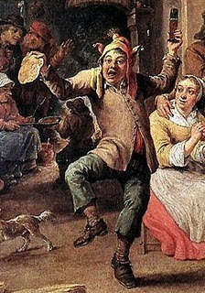
Lord of Misrule
Hallelujah or Humbug?

Slide 10
Hallelujah or Humbug?

Slide 11
The 12 days of Christmas
1 Partridge in a Pear Tree - Birth of Christ
2 Turtle Doves - The Old and New Testament
3 French Hens - Faith, Hope and Charity,
4 Calling Birds - the 4 Gospels
5 Golden Rings - The first 5 Books of the Old Testament
6 Geese A-laying - the 6 days of
creation
Hallelujah or Humbug?

Slide 12
The 12 days of Christmas
7 Swans A-swimming - the 7 gifts of the Holy Spirit, or 7 sacraments
8 Maids A-milking - the 8 beatitudes
9 Ladies Dancing - the 9 Fruits of the Holy Spirit
10 Lords A-leaping - the 10 commandments
11 Pipers Piping - the 11 faithful apostles
12 Drummers Drumming - the 12
points of doctrine in the Apostle's Creed
Hallelujah or Humbug?

Slide 13
Hallelujah or Humbug?

Slide 14
The Yule log
From 6th-7th century
Anglo-saxon
paganism
Hallelujah or Humbug?

Slide 15
Hallelujah or Humbug?

Slide 16
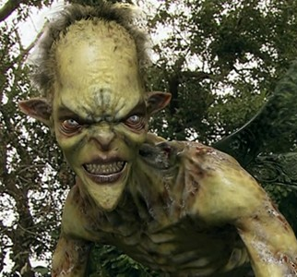
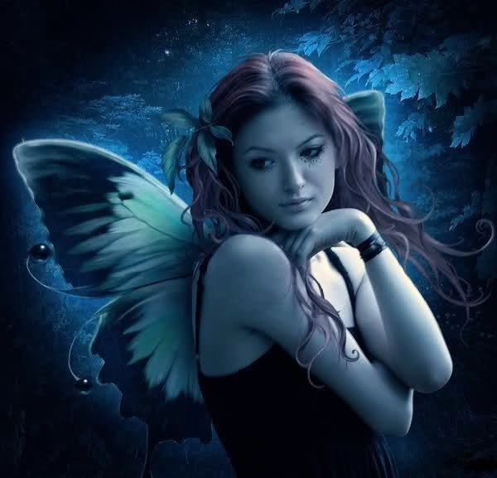
Holly
Originally to ward off malevolent fairies
Christianized to represent crown of thorns
.
.
.
.
.
.
.
.
Hallelujah or Humbug?

Slide 17
Hallelujah or Humbug?

Slide 18
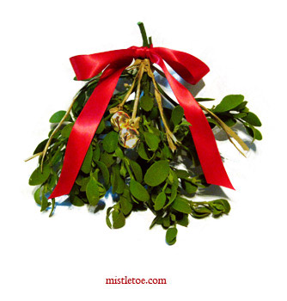
Mistletoe
Associated with virtually every ancient fertility cult
“Kissing” tradition dates back to Saturnalia
Hallelujah or Humbug?

Slide 19
Hallelujah or Humbug?

Slide 20
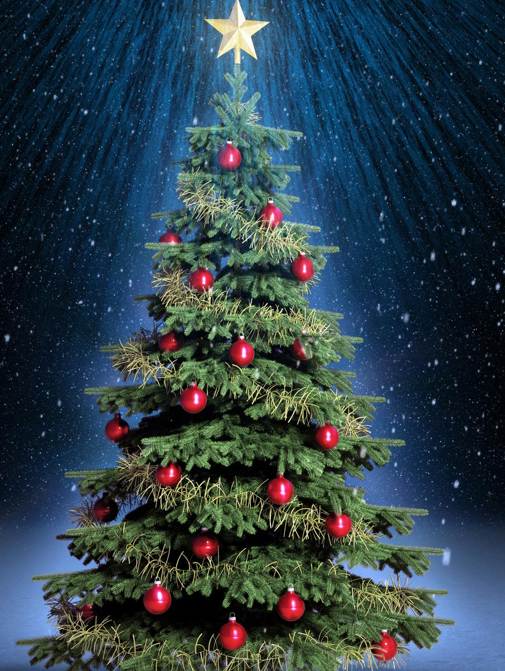
Christmas tree
Strong tradition traces it back to St. Boniface (AD 675?-754) of Germany
Father
Son
Holy Spirit
Hallelujah or Humbug?

Slide 21
Hallelujah or Humbug?

Slide 22
S
A
T
N
T
C
L
A
U
A
N
A
S
A=1
B=2
C=3
D=4, ect.
19
1
14
20
1
3
12
1
21
19
19+1+14+20+1+3+12+1+21+19=111
111
X 6
(Total)
(# of man)
666
(Mark of the Beast)
Hallelujah or Humbug?

Slide 23
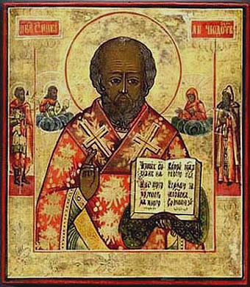
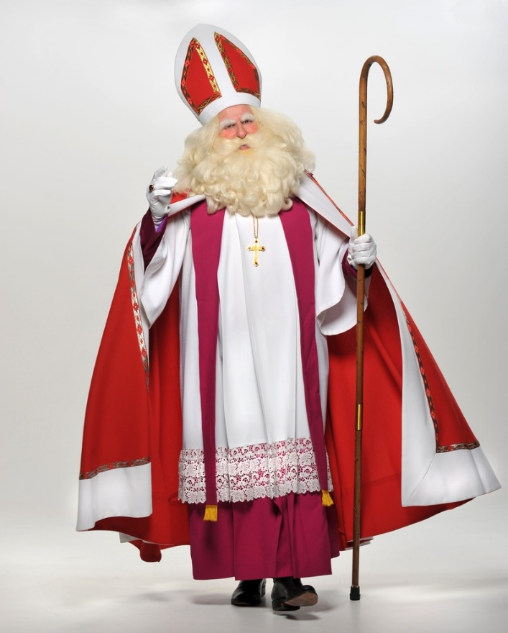
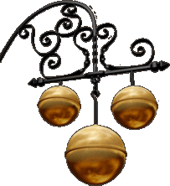
St. Nicolas, bishop of Myra (AD 270-343)
Hallelujah or Humbug?

Slide 24
Hallelujah or Humbug?

Slide 25
Hallelujah or Humbug?

Slide 26
So what do we do with Santa?
1. Let the kids think there is a Santa Claus
2. Let him be part of the celebration but be truthful about him
3. Have nothing to do with him
Hallelujah or Humbug?

Slide 27
Hallelujah or Humbug?

Slide 28
When “Christmas” becomes “Xmas”
“X” is actually the Greek character for “chi” – the 1st letter in the word for “Christ”
Cristo"
Christ
mas
X
x
Comes from an Old English phrase meaning “the mass of Christ”
Hallelujah or Humbug?

Slide 29
Hallelujah or Humbug?

Slide 30


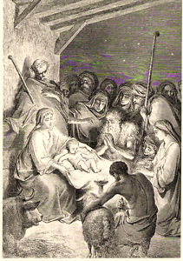
be to all who can afford them.
For unto you will be given great presents, wrapped in bright paper, lying beneath a tree adorned with tinsel, colored balls and lights. And suddenly, there will be with you a multitude of relatives and friends,
pick it up tomorrow. Thank goodness, Christmas only comes once a year!' And they shall go with haste to their cold bed and find their desired rest.'"
'Thank you so much…it was just what I wanted!' And it shall come to pass as the friends and the relatives have gone away unto their own homes, the parents shall say to one another, 'Darn it! What a mess to clean up! I'm tired…let's go to bed and pick it up
be to all who can afford them. For unto you will be given great presents, wrapped in bright paper, lying beneath a tree adorned with tinsel, colored balls and lights. And suddenly, there will be with you a multitude of relatives and friends, praising you and saying,
And there were in that same country children keeping watch over their stockings by the fireplace. And lo, Santa Claus came upon them; and they were sore afraid. And Santa said to them, "Fear not, for behold, I bring you good tidings of great joy which will
Luke 2
The
“Holey”
Bible
(New Apostate Version)
Hallelujah or Humbug?

Slide 31
Hallelujah or Humbug?

Slide 32
John 15:18 ~ If the world hates you, you know that it hated Me before it hated you.
1 John 3:13 ~ Do not marvel, my brethren, if the world hates you.
1 Cor. 2:14 ~ But the natural man does not receive the things of the Spirit of God, for they are foolishness to him; nor can he know them, because they are spiritually discerned.
Hallelujah or Humbug?

Slide 33
Hallelujah or Humbug?

Slide 34
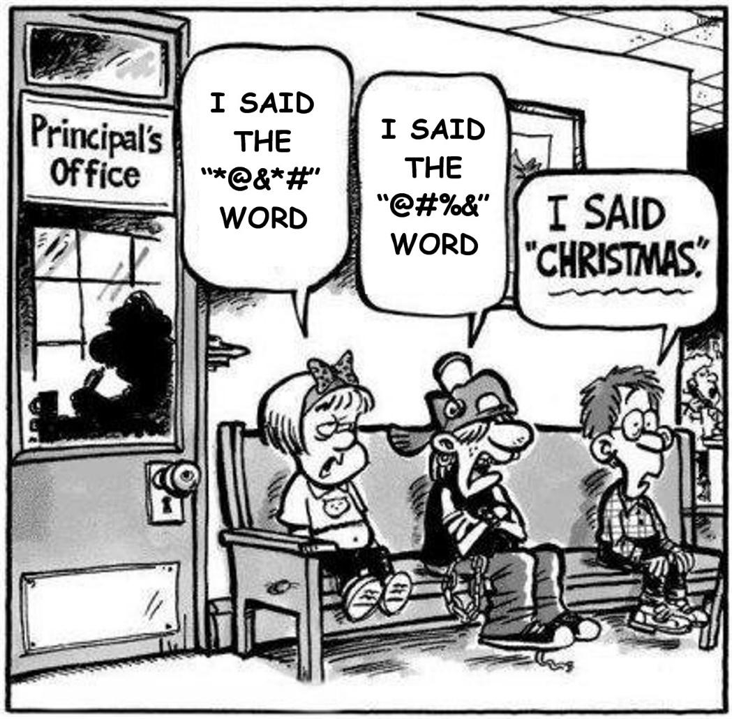
Hallelujah or Humbug?

Slide 35
Hallelujah or Humbug?

